Slide 1
CHAPTER 1
AN OVERVIEW OF TELECOMMUNICATIONS

Slide 2
What is Telecommunication?
Telecommunication
  Transfer of meaningful information from sender to receiver over cable or wireless media
  Includes all of the hardware and software necessary for its transmission and reception
Telephony
  Limited to transmission of sound over wire or wireless
  Assumes temporarily dedicated point-to-point connection rather than broadcast connection
Distinction between Telecom and Telephony
  Difficult to distinguish because of the use of digital techniques (binary bits) for transmitting any form of information (audio, video or data)

Slide 3
History of Telecom:
An Overview
1837: Samuel Morse invents the telegraph
1858: Transoceanic telegraph cable is laid
1876: Alexander Graham Bell invents the telephone
1885: Incorporation of AT&T
1888: Hertz discovers the electromagnetic wave
1895: Marconi begins experimenting with wireless telegraph

Slide 4
History of Telecom Technologies
Telegraph
  Morse telegraph of 1837 was designed to print patterns at a distance. The patterns consisted of dots (short beeps) and dashes (long beeps) corresponding to the Morse code
  Information rate varied between 5-to-100 words-per-minute

Slide 5
History of Telecom Technologies
Telephone
  In the earliest magneto-telephone, speaker’s voice was converted into electrical energy patterns that were sent over wires. At the receiving end, these energy patterns were converted back to sound waves.
  Information rate was limited only by the rate of human speech

Slide 6
History of Telecom Technologies
Radio
  The first radio was built in the U.S. in 1906
  Human voice was encoded, superimposed onto electromagnetic waves, and transmitted to receivers. The receivers decoded the information and it was converted to speech by the speakers.
  A wartime ban on nonmilitary broadcasting delayed the acceptance of radio; first commercial broadcast began in 1920
  World War II was stimulus to wireless communications

Slide 7
History of Telecom Technologies
Computer
  First large-scale automatic digital computer, Mark I, developed by Aiken between 1939 and 1944.
  Two turning points for the computing industry:
    Transistor, which was invented in 1948 Bardeen, Brattain and Shockley at the Bell Telephone Labs; and
    IC (integrated Circuit) was invented in 1961
  There has been an unprecedented growth in computer applications since the Internet and desktop computers came together in the early 1980s.

Slide 8
History of Telecom Industry
  Since its inception in 1885, AT&T has dominated the telecom market. Four-wire trunk-side access was available only to AT&T, while all other IXCs had two-wire line-side access. The two-wire line-side access does not support ANI (Automatic Number Identification: the ability to automatically identify the calling station).
  As a result, the company became a subject of recurrent antitrust actions.

Slide 9
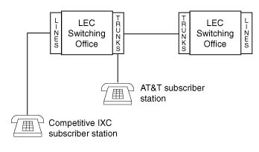
Line-access versus Trunk-side access

Slide 10
Antitrust Lawsuit Against AT&T
US Justice Department filed an antitrust lawsuit against AT&T in early 1974
Outcome was a restructuring agreement, which led to the divestiture (breakup) of AT&T, effective January 1, 1984

Slide 11
Outcomes of the
Divestiture of AT&T
Formation of seven Regional Bell Operating Companies (RBOCs), same as Baby Bells
    Provide local services at heavily regulated prices in return for governmental guarantee that they would be the only market provider and would earn a reasonable profit

Slide 12
Outcomes of the
Divestiture of AT&T (continued…)
Equal Access
  All IXCs have connections (four-wire trunk access) that are identical to that for AT&T at the POP (Point of Presence)
  LECs upgraded their equipment from Feature Group C to Feature Group D
  Callers pre-subscribe to an IXC but can reach other IXCs by dialing a carrier access code, 101XXXX, where XXXX is a unique number assigned to each IXC

Slide 13
Outcomes of the
Divestiture of AT&T (continued…)
Local Access and Transport Area (LATA): A predetermined area used to govern who would carry calls in what area
  IntraLATA (Within the local calling area)
    LEC: Access and Transport
  InterLATA (Includes Interstate and Intrastate)
    LEC: Access
    IXC: Transport

Slide 14
Telecom Networks
Network:
  Series of points or nodes interconnected by communication paths.
Switching Exchanges:
  Connection points or network nodes
Backbone:
  Larger transmission line that interconnects smaller lines

Slide 15
Telecom Networks: Benefits
Powerful, flexible collaboration
Cost-effective sharing of equipment
Software management
Freedom to choose the right tool
Flexible use of computing power
Secure management of sensitive information
Easy, effective worldwide communication

Slide 16
Internet
1969: ARPANET was funded by the DARPA commitment to a standard communication protocol
1978: Unix-to-Unix copy program
1981: Development of CSNET and BITNET
1982: Term Internet is coined
1986: Establishment of NSFNET
1989: CSNET and BITNET merge to form CREN
1990: WWW becomes part of the Internet

Slide 17
Classification of Data Networks
Classification by Spatial Distance
  WAN (Wide Area Network)
    More than 50 km, private/public, kbps to Mbps
  MAN (Metropolitan Area Network)
    5 to 50 km, private/public, kbps to Mbps
  LAN (Local Area Network)
    Less than 5 km, private, Mbps to Gbps

Slide 18
Classification of Data Networks continued…
Classification by Topology
  Ring
  Bus
  Star
  Tree
  Mesh
  Hybrid

Slide 19
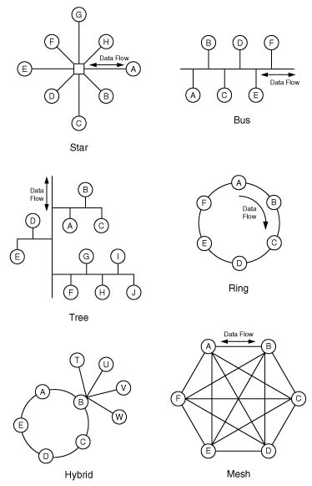
Network Topologies

Slide 20
Classification of Data Networks by Ownership
Public Network
  Owned by a common carrier
Private Network
  Built for exclusive use by a single organization
Virtual Private Network
  Encrypted tunnels through a shared private or public network

Slide 21
Classification of Data Networks by Switching Technology
Circuit Switching
  Connection-oriented networks, ideal for real-time applications, guaranteed quality of service
Message Switching
  Store-and-forward system
Packet Switching
  Shared facilities, Used for data communications
Cell Switching
  Fast processing of fixed length cells

Slide 22
Classification of Data Networks by Computing Model
Distributed Computing
  Client/Server set-up
Centralized Computing
  Thin-client architecture
Some Useful Telecom Terms
  Scalability: Ability to increase the power and/or number of users without major redesigns
  RAID (Redundant Array of Independent Disks)
  UPS (Uninterruptible Power Supply)

Slide 23
Classification of Data Networks by Type of Information
Data Communications
  Digital transmission of information
Voice Communications
  Telephone communications
Video Communications
  Cable TV or video conferencing

Slide 24
Telecom Standards
International Standards Organizations
  ISO (International Standards Organization)
  ITU (International Telecommunications Union)
  IEEE (Institute of Electrical and Electronics Engineers)
National Regulatory and Standards Organizations
  FCC (Federal Communications Commission)
  ANSI (American National Standards Institute)
  TIA (Telecommunications Industry Association)

Slide 25
Telecom Standards
European Standards Organizations
  CEPT (European Conference of Postal and Telecommunications Administrations)
  ETSI (European Telecommunications Standards Institute)
De facto Standards
Open Computing

Slide 26
Careers in Telecommunications
Wide variety of opportunities in diverse fields
  Life sciences, business office, movie & game industry, manufacturing, telecom companies
Telecom engineers and technicians
  Hardware
  Software
Network administration
  Security management
  Storage management
Project management

